Slide 1
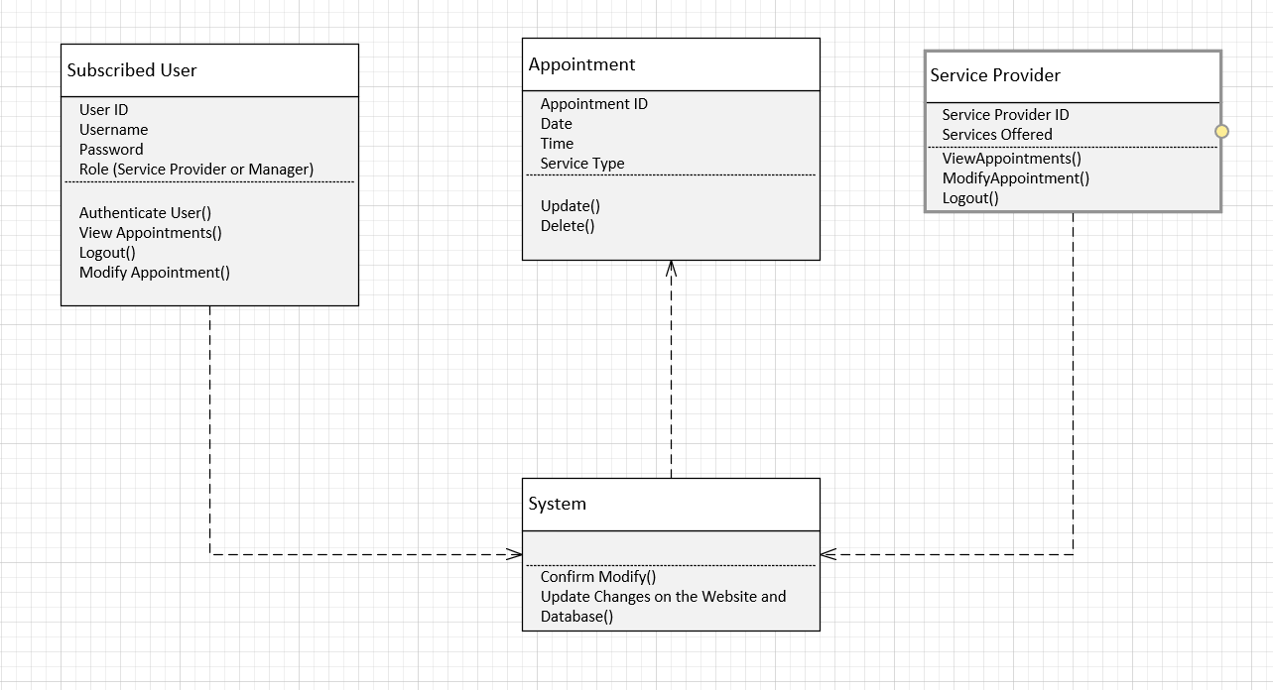
02.05 Modify Appointment Class Diagram

Slide 2
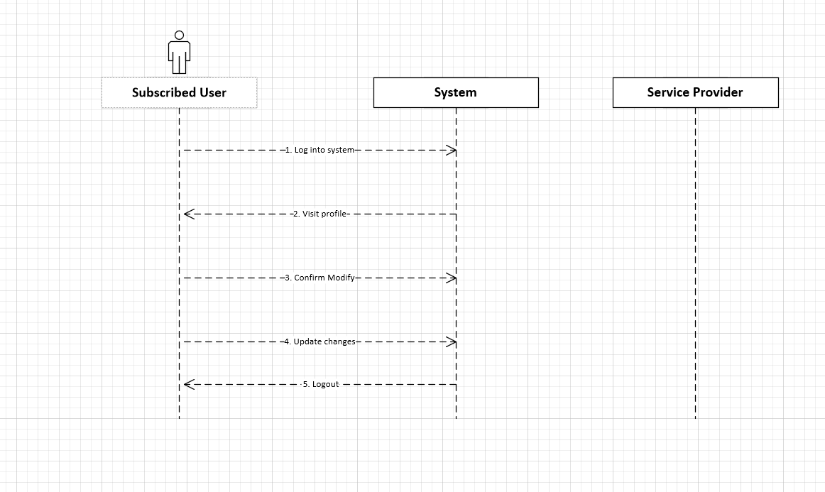

02.05 Modify Appointment Sequence Diagram

Slide 3
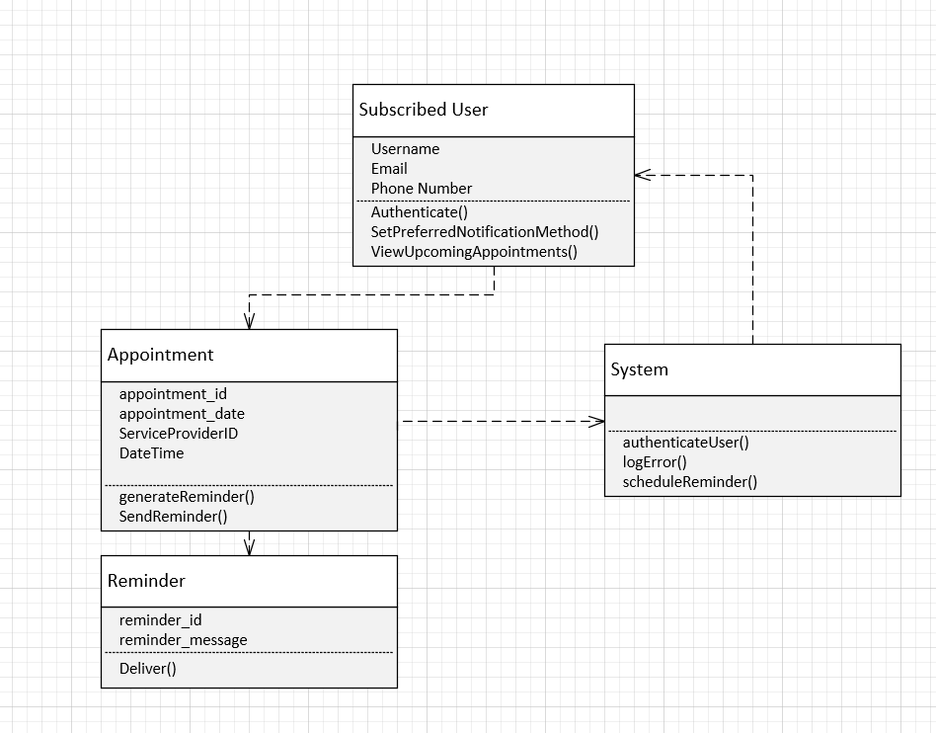
02.06 Send Remainder Class Diagram

Slide 4
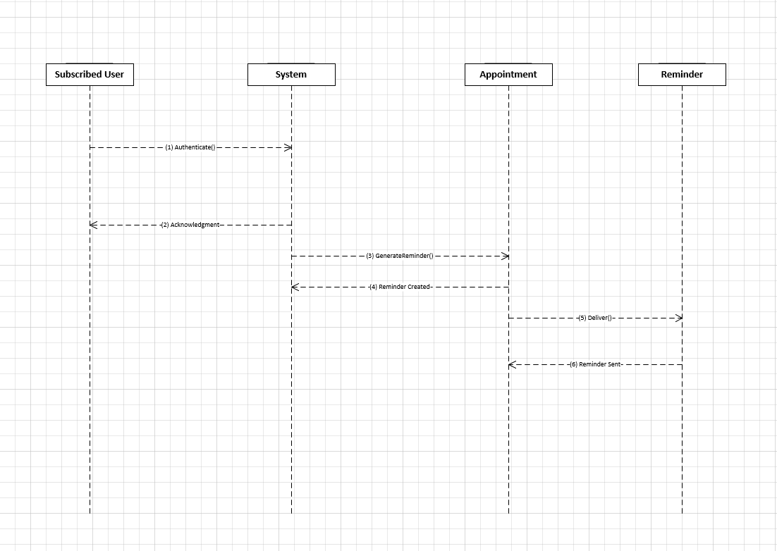
02.06 Send Remainder Sequence Diagram

